Slide 1
Ecommerce Management System

Slide 2
OBJECTIVE
The objective of this project is to develop a comprehensive SQL-based eCommerce Data Management System that ensures efficient data handling, real-time reporting, and process automation. The system covers dynamic customer loyalty updates, country-wise sales classification, pivot analytics, and customer insights. It also includes stored procedures for personalized order tracking and spending summaries, as well as database triggers to automate loyalty point assignments and maintain inventory consistency after each transaction. This approach ensures data integrity, operational efficiency, and scalable business logic integration for modern eCommerce platforms.

Slide 3
What is My SQL ?
MySQL is the most popular opensource relational database management system.
MySQL used for developing various web-based software development.
Developed by company MySQL AB. (Based on CNC++)
Features of MYSQL
Relational Database Management System (RDBMS)
Easy to use
Storing Data is secure
Open Source & Free to download
Compatible on many Operating systems.

Slide 4
STEPS INVOLVED
STEP 1 : Create Database CREATE DATABASE my_database;
STEP 2: Use Database
USE my_database;

Slide 5
TABLE IMPORT:
The Table Data Import Wizard in MySQL Workbench allows users to import data from external sources like CSV or Excel files directly into a MySQL table. It is a user-friendly GUI tool that simplifies the process of populating or creating tables from files without writing SQL manually
FIELDS
CUSTOMERS DETAILS
ORDERS DETAILS
PAYMENTS DETAILS
PRODUCTS DETAILS
SHIPPING DETAILS

Slide 6
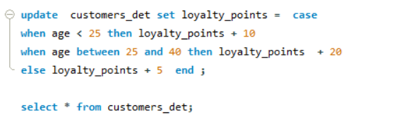
Project Task 1
CRITERIA:
Update Loyalty Points for customers based on age.
age <25 then add 10 loyalty points
age between 25 and 40 then add 20 loyalty points
otherwise add 5 loyalty points
QUERY:

Slide 7
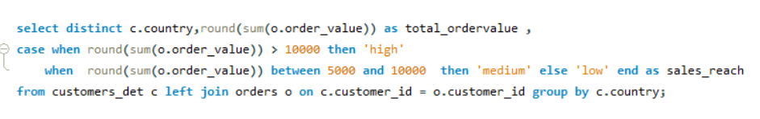
Project Task 2
CRITERIA:
Get total order value per country and classify sales category.
sum(order_value) >100000 then "High"
sum(order_Value) between 50000 and 100000 then "medium"
other wise Low
QUERY:

Slide 8
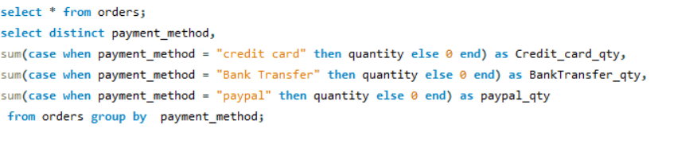
Project Task 3
CRITERIA:
Pivot total order quantity per payment method.
QUERY:

Slide 9
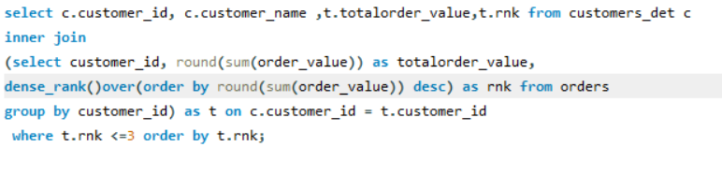
Project Task 4
CRITERIA:
Top 3 customers by total order value and Customer_id (using Rank).
QUERY:

Slide 10
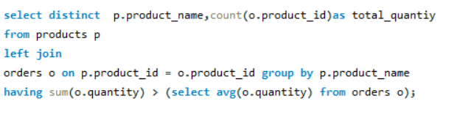
Project Task 5
CRITERIA:
Products that have been ordered more than the average quantity.
QUERY:

Slide 11
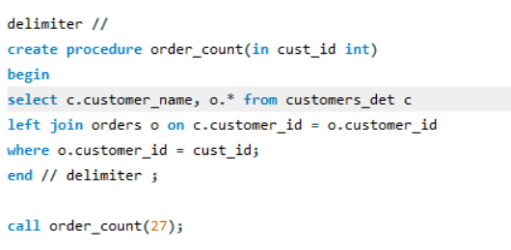
Project Task 6
CRITERIA:
Retrieving all orders for a specific customer using customer id
QUERY:

Slide 12
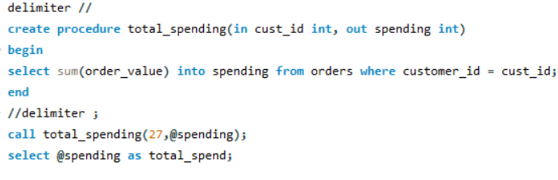
Project Task 7
CRITERIA:
Returning the total spending of a customer.
QUERY:

Slide 13
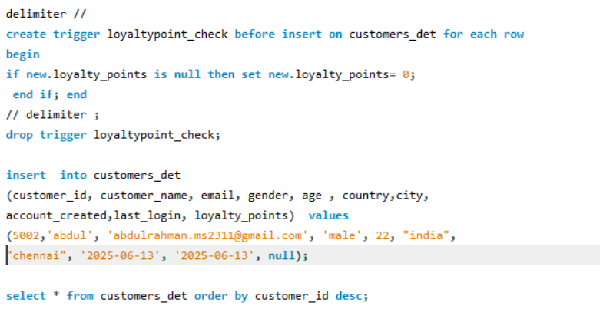
Project Task 8
CRITERIA:
Automatically setting loyalty points to 0 if NULL on insert.
QUERY:

Slide 14
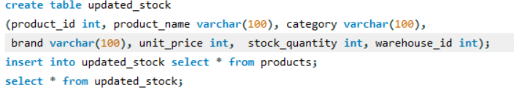
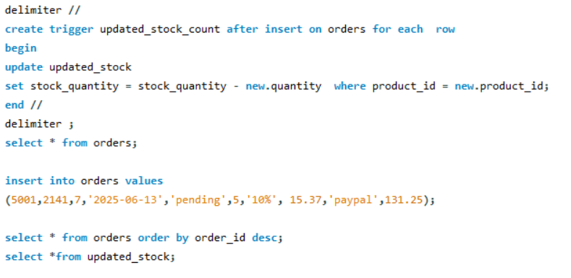
Project Task 9
CRITERIA:
After a new order is inserted, deducting quantity from product stock.
QUERY:

Slide 15
THANK YOU…!!

